Slide 2
Ephesians 2:8
For by grace you have been saved through faith; and that not of yourselves, it is the gift of God.

Slide 3
Different words for Salvation
Redemption
Justification
Sanctification
Propitiation

Slide 4
Ephesians 1:7
In Him, we have redemption through His blood, the forgiveness of our trespasses, according to the riches of His grace which He lavished on us.

Slide 5
Redemption
Luo, “to loose.”
Lutron, “a ransom payment to secure freedom for a slave, or to secure release from obligations.”
Lutrosis, apo-lutrosis, “the process of setting free by paying a ransom; redemption.”

Slide 6
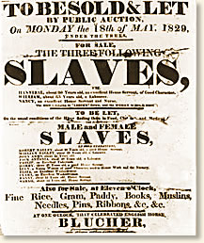
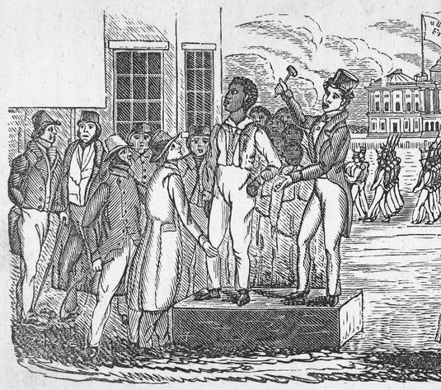

Slide 7
Acts 8:20-23
Peter said to him, “May your silver perish with you, because you thought you could obtain the gift of God with money! You have no part of portion in this matter, for your heart is not right before God. Therefore repent of this wickedness of yours, and pray the Lord that, if possible, the intention of your heart may be forgiven you. For I see that you are in the gall of bitterness and in the bondage of iniquity.”

Slide 8
2 timothy 2:24-26
The Lord’s bond-servant must not be quarrelsome, but be kind to all, able to teach, patient when wronged, with gentleness correcting those who are in opposition, if perhaps God may grant them repentance leading to the knowledge of the truth, and they may come to their senses and escape from the snare of the devil, having been held captive by him to do his will.

Slide 9
Matthew 20:28
The Son of Man did not come to be served, but to serve, and to give His life a ransom for many.

Slide 10
1 Peter 1:18-19
You were not redeemed with perishable things like silver or gold from your futile way of life inherited from your forefathers, but with precious blood, as of a lamb unblemished and spotless, the blood of Christ.

Slide 11
Revelation 5:8
And they sang a new song, saying, “Worthy are You to take the book and to break its seals; for You were slain, and purchased for God with Your blood men from every tribe and tongue and people and nation”

Slide 12
1 Corinthians 6:19-20
…you are not your own. For you have been bought with a price; therefore, glorify God in your body.

