Slide 7
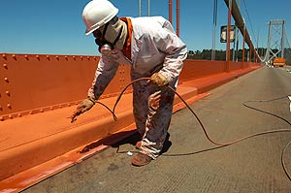

Slide 9
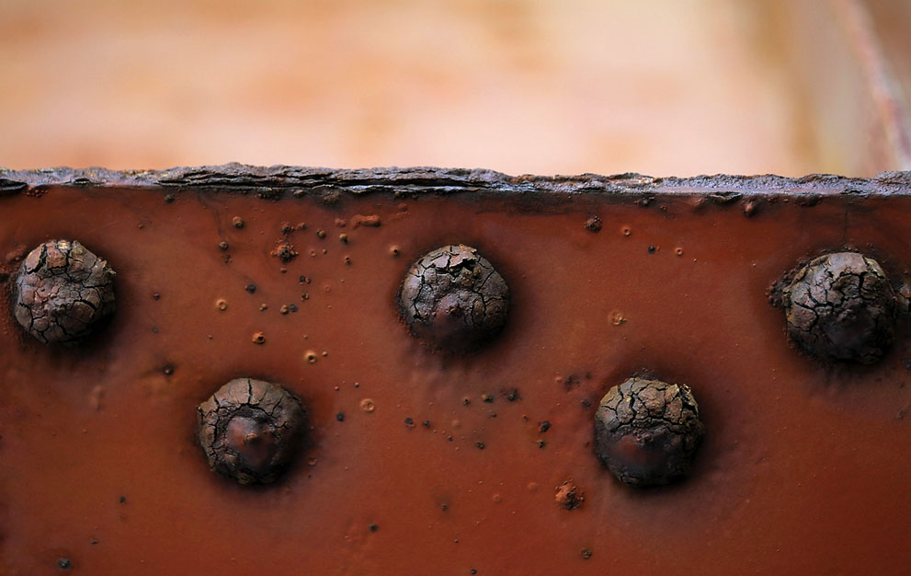

Slide 10
Things That Need Constant Upkeep
Our relationship with God in reading (1 Pet. 2:2, 2 Pet. 1:12-13), in prayer (Phil. 4:6), in worship (Eph. 5:18-19), and in work (2 Pet. 1:8-10).
Our relationship with our spouse (Eph. 5:28-30) and our children (Eph. 6:4).
Our efforts for the church, to cause it to grow numerically (Acts 6:7) and spiritually (1 Pet. 5:1-4, Heb. 13:17).

Slide 11
Nehemiah’s Example
13:4-9, foreigners living inside the temple.
13:10-14, failure to give tithes to the Levites.
13:15-22, ignoring the Sabbath.
13:23-30, contracting immoral marriages.

