Slide 2
Philippians 2:8
Being found in appearance as a man, He humbled Himself by becoming obedient to the point of death, even death on a cross.

Slide 3
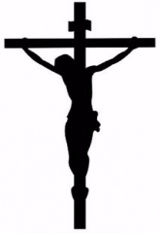
Crucifixion
Invented by the Persians to maximize pain and strike fear into the hearts of onlookers.
The Romans adopted it, but found ways to make it worse, by affixing condemned people to the pole with nails or straps.

Slide 4
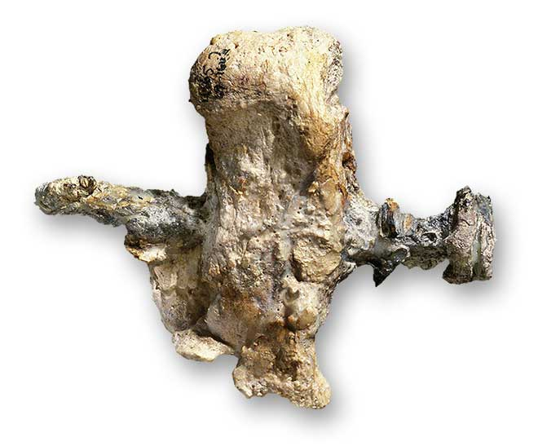

Slide 5
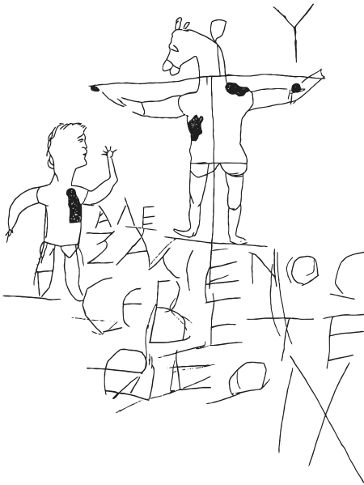

Slide 6
Why A Cross?
He Bore the Curse for Mankind

Slide 7
Galatians 3:10-14
For as many as are of the works of the Law are under a curse; for it is written, “Cursed is everyone who does not abide by all things written in the book of the Law, to perform them.” Now, that no one is justified by the Law before God is evident; for, “The righteous man shall live by faith.” However, the Law is not of faith; on the contrary, “He who practices them shall live by them.”

Slide 8
Galatians 3:10-14
Christ redeemed us from the curse of the Law, having become a curse for us—for it is written, “Cursed is everyone who hangs on a tree”—in order that in Christ Jesus the blessing of Abraham might come to the Gentiles, so that we would receive the promise of the Spirit through faith.

Slide 9
Deuteronomy 21:22-23
If a man has committed a sin worthy of death and he is put to death, and you hang him on a tree, his corpse shall not hang all night on the tree, but you shall surely bury him on the same day, for he who is hanged is accursed of God, so that you do not defile your land which the Lord your God gives you as an inheritance.

Slide 10
2 Corinthians 5:21
He made Him who knew no sin to be sin on our behalf, so that we might become the righteousness of God in Him.

