Slide 2
Acts 6:1-2
Now at that time while the disciples were increasing in number, a complain arose on the part of the Hellenistic Jews against the native Hebrews, because their widows were being overlooked in the daily serving of food. So the twelve summoned the congregation of the disciples and said…

Slide 3
“Disciple”
Word found almost 300 times in the New Testament
Vine’s Dictionary says that it literally means “learner,” but is used in the sense of “follower” or “adherent.”

Slide 4
What Does a Disciple Do?
A disciple learns
A disciple obeys

Slide 5
John 8:32
If you abide in My word, then you are truly disciples of Mine; and you shall know the truth, and the truth shall make you free

Slide 6
John 15:8
My Father is glorified by this, that you bear much fruit, and so prove to be My disciples.

Slide 7
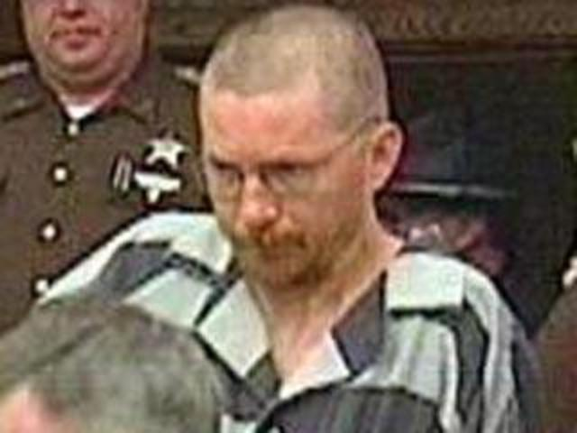
In 2005, Charles Hickman confessed to murder in Indiana.
A few days later Hickman was released, and another man, Anthony Stockelman, was arrested for the murder.

Slide 8
John 13:35
By this all men will know that you are My disciples, if you have love for one another.

Slide 9
What Does a Disciple Do?
A disciple learns
A disciple obeys
A disciple follows

Slide 10
Mark 1:16-20
…He saw Simon and Andrew, the brother of Simon, casting a net in the sea; for they were fishermen. And Jesus said to them, “Follow Me, and I will make you become fishers of men.” Immediately they left their nets and followed Him. Going on a little farther, He saw James the son of Zebedee, and John his brother, who were also in the boat mending nets. Immediately He called them; and they left their father Zebedee in the boat with the hired servants, and went away to follow Him.

Slide 11
Matthew 16:24
If anyone wishes to come after Me, he must deny himself and take up his cross and follow Me.

Slide 14
What Does a Disciple Do?
A disciple learns
A disciple obeys
A disciple follows
A disciples leads others

Slide 15
Matthew 28:18-20
All authority has been given to Me in heaven and on earth. Go therefore and make disciples of all the nations, baptizing them in the name of the Father and the Son and the Holy Spirit, teaching them to observe all that I commanded you; and lo, I am with you always, even to the end of the age

