Slide 1
Eternal Life
Subtitle

Slide 2
Kenny Chesney
Everybody wants to go to heaven
Have a mansion high above the clouds
Everybody wants to go to heaven
But nobody wants to go right now.

Slide 3
Craig Campbell
Now it says in the King James, in the Almighty’s kingdom,
He mentions a mansion that He’s built just for me.
Now I’d gladly trade it for a farm house with acreage
And a back yard that’s shaded and a squeaky front porch swing.
That’s where I wanna hang my wings.
When I die I wanna live on the outskirts of Heaven,
Where there’s dirt roads for miles, hay in the fields, and fish in
the river,
Where there’s dogwood trees and honey bees,
And blue skies and green grass forever.
So Lord when I die I wanna live on the outskirts of Heaven.

Slide 4
Hank Williams Jr.
If Heaven ain’t a lot like Dixie,
I’d just as soon stay home.

Slide 5
Life in the Son
John 5:19-29
John 11:23-27

Slide 6
Genesis 2:15-17
2
+
2
+
“…in the day that you eat from it, you will surely die.”

Slide 7
Genesis 3:23-24
2
+
2
+
“…So He drove the man out, and at the east of the garden of Eden He stationed the cherubim...”

Slide 8
Ephesians 2:1-10
2
+
2
+
“…and you were dead in your trespasses and sins…”

Slide 9
1 Timothy 5:6
2
+
2
+
“…she who gives herself to wonton pleasure is dead even while she lives.”

Slide 10
Colossians 1:9-14
“…He rescued us from the domain of darkness, and transferred us to the kingdom of His beloved Son…”

Slide 11
John 3:3-8
“…unless one is born of water and the Spirit, he cannot enter into the kingdom of God.”

Slide 12
Role of the Spirit in the New Creation
Giver of life (Ezekiel 36-37)

Slide 13
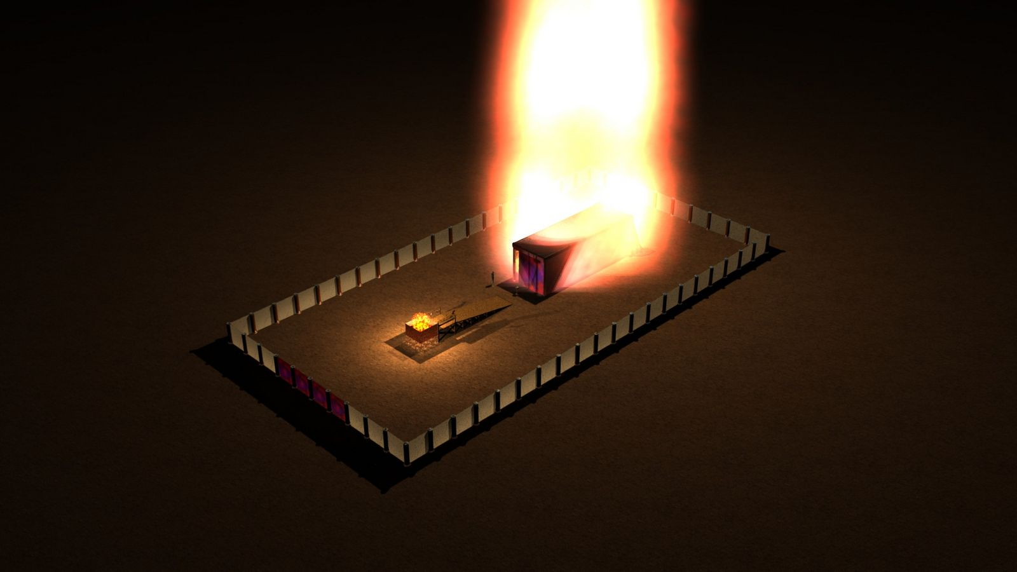
The Spirit of God moved into the holy place
-Exo. 40:34

Slide 14
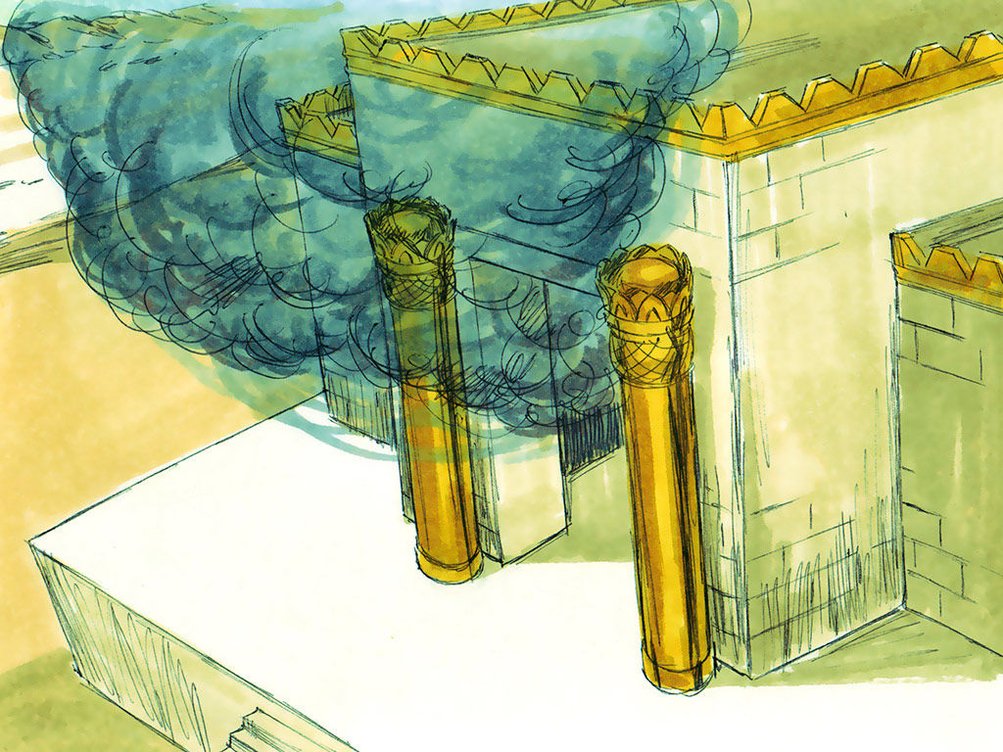
The Spirit of God moved into the holy place
-1 Kin. 8:10

Slide 15
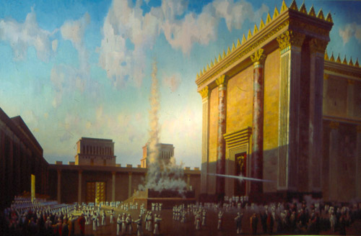
The Spirit of God moved out of the holy place
-Ezek. 10:18

Slide 16
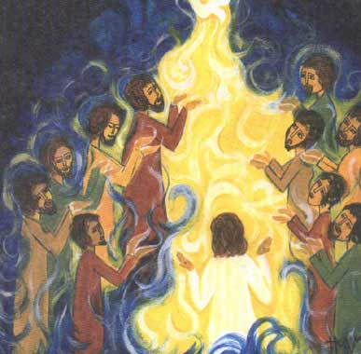
The Spirit of God moved into the holy place
-John 20:22

Slide 17
Romans 5:12-17
“…so then as through one transgression there resulted condemnation to all men, even so through one act of righteousness there resulted justification of life to all men…”

Slide 18
Romans 8:1-17
“…if you are living according to the flesh, you must die; but if by the Spirit you are putting to death the deeds of the body, you will live.”

Slide 19
Romans 6:3-14
“Even so, consider yourselves to be dead to sin, but alive to God in Christ Jesus. Therefore do not let sin reign in your mortal body so that you obey its lusts.”

Slide 20
Revelation 21:22-22:4
Presence of God, face to face
Nothing unclean
Water of life
Tree of life
No longer any curse
Reign forever and ever

Slide 21
Romans 8:18-25
“…the anxious longing of creation waits eagerly for the revealing of the sons of God…”

Slide 22
Philippians 3:27-21
“…For our citizenship is in heaven, from which also we eagerly wait for a Savior, the Lord Jesus Christ; who will transform the body of our humble state into conformity with the body of His glory…”

