Slide 2
John 5:28-29
Do not marvel at this, for an hour is coming in which all who are in the tombs will hear His voice, and will come forth; those who did the good deeds to a resurrection of life, those who committed the evil deeds to a resurrection of judgment.

Slide 3
2 Corinthians 5:9-10
We also have as our ambition, whether at home or absent, to be pleasing to Him. For we must all appear before the judgment seat of Christ, so that each one may be recompensed for his deeds in the body, according to what he has done, whether good or bad.

Slide 4
Revelation 20:12
I saw the dead, the great and the small, standing before the throne, and books were opened; and another book was opened which is the book of life; and the dead were judged from the things which were written in the books, according to their deeds.

Slide 5
Matthew 12:36
I tell you that every careless word that people speak, they shall give an accounting for it in the day of judgment.

Slide 6
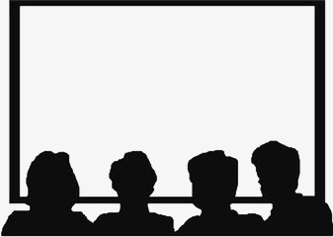

Slide 7
Hebrews 4:15
We do not have a high priest who cannot sympathize with our weaknesses, but One who has been tempted in all things as we are, yet without sin.

Slide 8
2 Corinthians 5:21
He made Him who knew no sin to be sin on our behalf, so that we might become the righteousness of God in Him.

Slide 9
1 Peter 1:18-19
You were not redeemed with perishable things like silver or gold from your futile way of life inherited from your forefathers, but with precious blood, as of a lamb unblemished and spotless, the blood of Christ.

