Slide 1
The Power to Mature in Christ

Slide 2
Ephesians 4:11-13
And He gave some as apostles, and some as prophets, and some as evangelists, and some as pastors and teachers, for the equipping of the saints for the work of service, to the building up of the body of Christ; until we all attain to the unity of the faith, and of the knowledge of the Son of God, to a mature man, to the measure of the stature which belongs to the fullness of Christ.

Slide 3
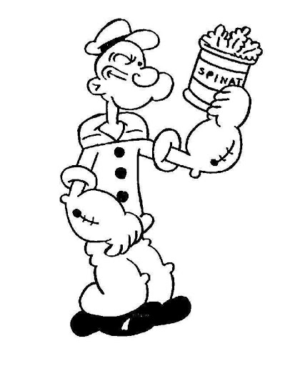
Excuse
This is just my personality.

Slide 4
James 1:13-14
Let no one say when he is tempted, “I am being tempted by God”; for God cannot be tempted by evil, and He Himself does not tempt anyone. But each one is tempted when he is carried away and enticed by his own lust.

Slide 5
Ephesians 3:14-19
For this reason I bow my knees before the Father, from whom every family in heaven and on earth derives its name, that He would grant you, according to the riches of His glory, to be strengthened with power through His Spirit in the inner man, so that Christ may dwell in your hearts through faith; and that you, being rooted and grounded in love, may be able to comprehend with all the saints what is the breadth and length and height and depth, and to know the love of Christ which surpasses knowledge, that you may be filled up to all the fullness of God.

Slide 6
Acts 17:30-31
God is now declaring to men that all everywhere should repent, because He has fixed a day in which He will judge the world in righteousness.

Slide 7
Ephesians 4:22-24
That, in reference to your former manner of life, you lay aside the old self, which is being corrupted in accordance with the lusts of deceit, and that you be renewed in the spirit of your mind, and put on the new self, which in the likeness of God has been created in righteousness and holiness of the truth.

Slide 8
2 Corinthians 5:10
If anyone is in Christ, he is a new creature; the old things passed away; behold, new things have come.

Slide 9
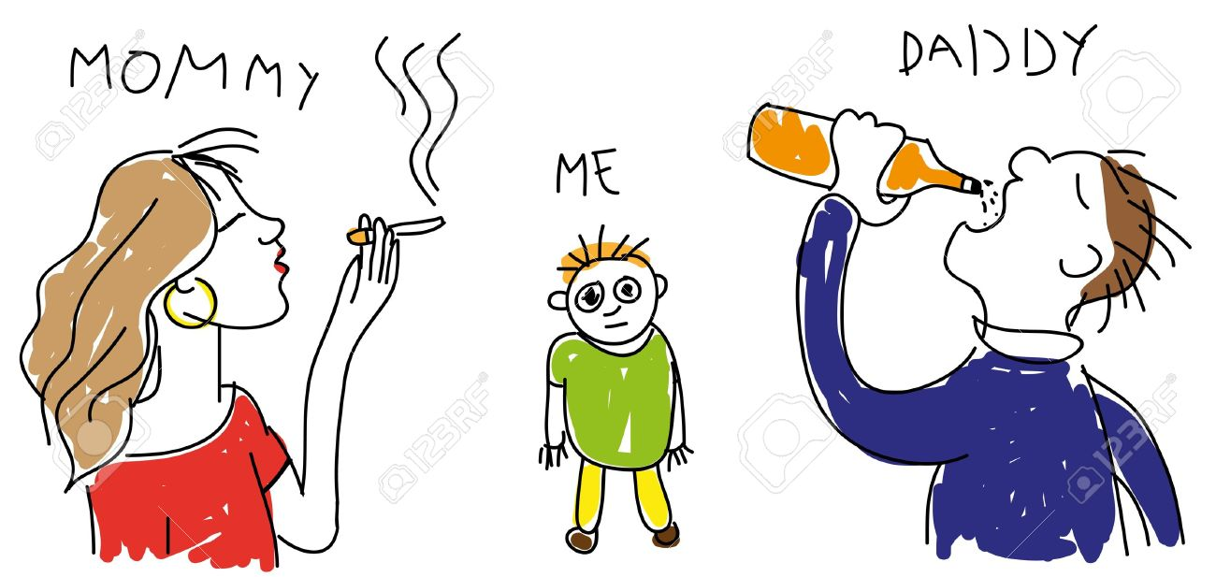
Excuse
My parents weren’t good examples.

Slide 10
Ezekiel 18:1-20
Behold, he has a son who observed all his father’s sins which he committed, and observing, does not do likewise…

Slide 11
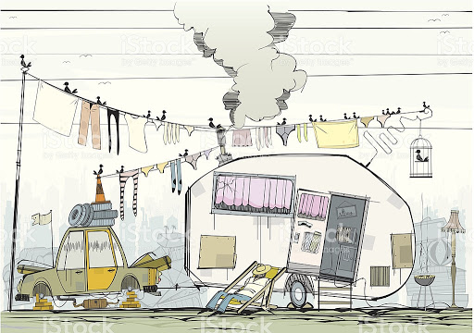
Excuse
My hometown culture is awful.

Slide 12
Matthew 7:13-14
Enter through the narrow gate; for the gate is wide and the way is broad that leads to destruction, and there are many who enter through it. For the gate is small and the way is narrow that leads to life, and there are few who find it.

Slide 13
Romans 12:1-2
Therefore I urge you, brethren, by the mercies of God, to present your bodies a living and holy sacrifice, acceptable to God, which is your spiritual service of worship. And do not be conformed to this world, but be transformed by the renewing of your mind, so that you may prove what the will of God is, that which is good and acceptable and perfect.

Slide 14
Daniel 1:8
Daniel made up his mind that he would not defile himself with the king’s choice food or with the wine which he drank...

Slide 15
Philippians 3:4-7
If anyone else has a mind to put confidence in the flesh, I far more: circumcised the eighth day, of the nation of Israel, of the tribe of Benjamin, a Hebrew of Hebrews; as to the Law, a Pharisee; as to zeal, a persecutor of the church; as to the righteousness which is in the Law, found blameless. But whatever things were gain to me, those things I have counted as loss for the sake of Christ.

Slide 16
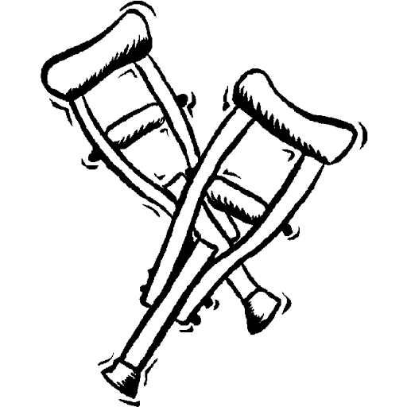
Excuse
It’s not a good time.

Slide 17
Philippians 3:13-14
Brethren, I do not regard myself as having laid hold of it yet; but one thing I do: forgetting what lies behind and reaching forward to what lies ahead, I press on toward the goal for the prize of the upward call of God in Christ Jesus.

